Slide 1

Introducing React
QUICK INTRODUCTION ON WHy REACT is DIFFERENT

Slide 2
What is React?
Developed and maintained by Facebook and Instagram
JavaScript library to build User Interfaces
Represent the V of the MVC pattern
Based on Components
Can be partially used on an existing stack
React Native for mobile apps.
Notes:
- History on why Facebook needed it - V so not comparable with Angular. If we want to compare, we would need to add Flux or Redux to manage flow
- Can also be used partially, e.g. backbone js or any MVC framework

Slide 3
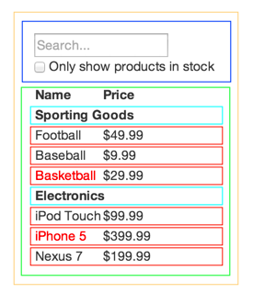
Based on components
Components are independent, reusable pieces.
each piece is in isolation.
Container > Table > Titles & Products
> Search
→ 5 components
Notes:
Next: jump to code

Slide 4
Created with JSX
JSX is a JavaScript preprocessor
Adds XML syntax to JavaScript
It’s not HTML or JavaScript syntax, it’s JSX
Notes:
We can add attributes on elements, such as class, id, style, etc.

Slide 5
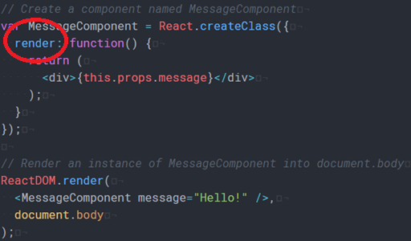
A component have methods
Each component have 15 methods
Mounting
Unmounting Lifecycle
Updating
Mandatory:
render()
Notes:
These methods are related to the life cycle of the component. Before/After it has been mounted, unmounted

Slide 6
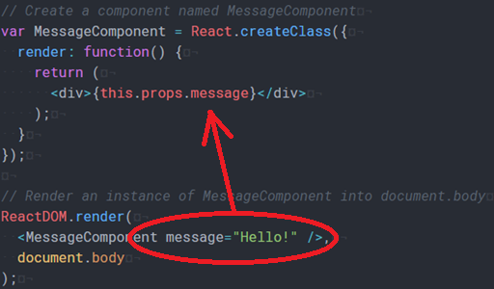
A component have props
Props are read-only
Can be compared to dependency injection
Props populated by Owner Component
Top-Down data flow

Slide 7
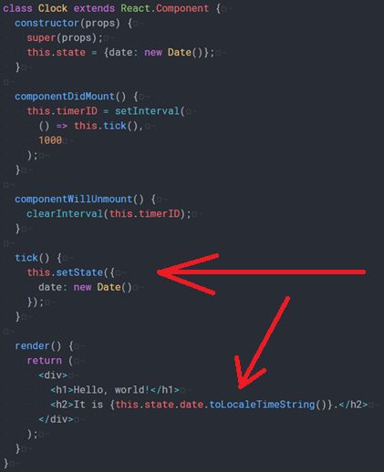
A component have A State
State is private and fully controlled by component
Updating state re-renders the component
If it’s not used in render(), it shouldn’t be in the state

Slide 8
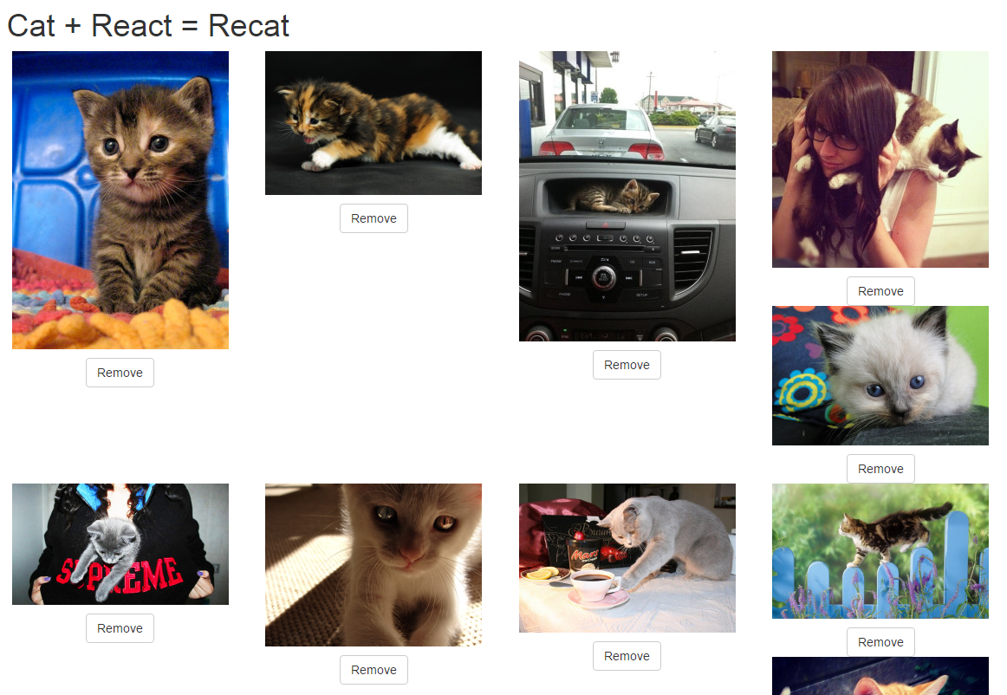
Code example
Recat: an app to load cat pictures using react and a third party API
URL: https://github.com/grenoult/recat

